Slide 1




Team Leader
Job Pack

Slide 2

Dear Applicant
Thank you for your interest in working for the HertsHelp Service, delivered by the Hertfordshire Advice Providers Partnership.
This job pack should give you everything you need to know to apply for this role and what it means to work with us.
In this pack you’ll find:
• Information about HertsHelp
• Purpose of the job
• Job description and person specification
• Interview and Application Process
• Candidate guidance notes
Want to chat about this role?
If you want to chat about the role further, contact recruitment@hertshelp.net to arrange an informal conversation
We look forward to hearing from you!
Giorgina Courtney
HertsHelp Service and Development Manager

Slide 3
Team Leader
Reporting to: Giorgina Courtney
Contract: Permenant
Salary: £27,000-£30,000
Hours: 37.5 Full Time Equivalent
Holidays: 27 days plus Public Holidays
Location: Hybrid 2 days in office.
Office base will be in Stevenage. There will be some travel across Hertfordshire for meeting/event attendance.
Flexibility: Required
Some evenings and/or weekends
to meet the needs of the service
Purpose of post
Responsible for the day-to-day supervision and development of a team of connecting officers and administrators to provide a high-quality service to residents of Hertfordshire.
The ideal candidate for the role of team leader will have an understanding of the complex issues that people can face as they go through life, and a passion for problem solving and connecting people to the right community services available across Hertfordshire.
This role supports the running the HertsHelp service, management and development of a team of connecting officers and administrators, management reporting, dealing with complaints, rostering and sorting out cover issues and is very much a “hands on” role.
You need to have a positive attitude towards training and supporting team members to deliver the service to a quality standard; and monitor case records to ensure they reach Quality of Advice Audit standards, and to play an active
role in the continuous improvement and development of the quality of advice.

Slide 4
Job Description | What you will be doing
Service Management:​
Oversee the day-to-day operations of the HertsHelp service, ensuring seamless delivery and optimal utilisation of resources.​
Collaborate with team members to address challenges, allocate tasks, and maintain efficient workflows.​
Implement continuous improvement initiatives to enhance the quality of advice and service effectiveness.​
Utilise in-depth knowledge of available community services across Hertfordshire to effectively connect individuals in need to appropriate resources. ​
Manage scheduling, shifts, and cover arrangements to maintain optimal staffing levels for seamless service delivery.​
Adapt to changing demands and make necessary adjustments to ensure consistent coverage. ​
Undertake Frontline work as and when required.​
​
Quality Monitoring: ​
Supervise the work of designated staff to ensure that standards meet HertsHelp Quality requirements.​
Monitor the case records / telephone calls of designated staff to meet quality standards and service level agreements.​
Ensure remedial and developmental issues are identified and acted on to develop individuals, improve the quality of service, and ensure clients do not suffer detriment due to poor or inadequate action.​
Keep technical knowledge up to date and provide technical support to connecting officers. ​
Ensure that appropriate systems are maintained for case recording, statistics, follow ​
up work and quality control.​

Slide 5
Job Description | What you will be doing
Team Supervision and Development:​
Lead, mentor, and guide the team of connecting officers and administrators to ensure the provision of exceptional service to Hertfordshire residents.​
Provide ongoing support and training to team members, fostering a positive and growth-oriented work environment.​
Monitor and maintain case records to ensure compliance with Quality of Advice Audit standards.​
Support direct reports with regular supervisions and annual appraisals. ​
Utilise the Support and Supervision framework to ensure that expected standards are achieved. ​
​
Management Reporting and Complaint Handling:​
Prepare management reports to provide insights into service performance and areas for improvement.​
Address and resolve complaints in a professional and timely manner, ensuring resident satisfaction.​
Ensure all relevant policies and procedures are followed at all times. ​
Ensure that staff are complying with Safeguarding requirements. ​
Ensure that issues of concern are dealt with appropriately including; confidentiality and the threat of harm.​
​
Continuous Improvement:​
Proactively identify opportunities to enhance service quality, operational efficiency, and team performance.​
Collaborate with relevant stakeholders to implement process improvements and best practices. ​
Abide by health and safety guidelines and share responsibility for own health and safety and that of colleagues.​
Identify own learning and development needs and take steps to address these.​
Carry out any other tasks within the scope of the post to ensure the effective delivery ​
and development of the service.​
Contribute to the delivery of the business strategy. ​

Slide 6
Person Specification | What you need to do this job
Understanding of the diverse challenges individuals encounter in their lives, with a genuine passion for assisting and connecting them to appropriate support services.​
​
To be non-judgmental and respect views, values and cultures that are different to your own​
​
Proven leadership experience in a dynamic and fast-paced environment.​
​
Excellent interpersonal and communication skills to engage effectively with team members. ​
​
Strong problem-solving skills, coupled with a positive attitude toward continuous learning and development.​
​
Ability to manage multiple priorities, remain adaptable in response to changing circumstances, and maintain a high level of organisation.​
​
Proficiency in record-keeping, data management, and producing management reports.​
​
Knowledge of local community resources and services within Hertfordshire is advantageous.​
​
Demonstrable understanding of the issues involved in interviewing clients, an up-to-date understanding of equality and diversity – it’s application to providing advice and the supervision and development of staff. ​
​
Proven ability to manage / supervise others including ability to recruit, develop and motivate staff as well as ability to give and receive feedback objectively and sensitively. ​
​
Proven ability to monitor and maintain service delivery against agreed targets as well as monitor and analyse statistics and check accuracy of calculations. ​
​
Proven ability to supervise and monitor advice work and to maintain casework systems and procedures, use of IT systems and packages, electronic resources in the provision of advice and the preparations of reports and submission.​
​
Ability to research, analyse and interpret complex information and work sensitively with client​

Slide 7
Person Specification | What you need to do this job
Essential | Desirable
Project management skills and experience | Project management qualification
Experience of working with multiple agencies and stakeholder | Ability to lead multi-agency project groups effectively
Communication skills excellent verbal skills to make your points concisely and impactfully. The ability to speak with confidence to a range of audiences. Written communication skills to absorb a range of information and provide high quality briefings, reports etc. Fully confident to maximise use of technology including the Microsoft suite of packages. | Call centre experience
Organisational skills to get things done on time and to meet or exceed desired outcomes. The ability to know when to delegate and when to keep close to issues. Planning ahead a keenness and mind-set that thinks and plans ahead in order that the time is used wisely, and reactional management is avoided.
Strong leadership -Managing and influencing people to enable team members to deliver and develop in their roles and to bring about results.
Innovation and managing change and the confidence and enthusiasm to come up with new ideas and implement change for continuous improvement.
Working with ambiguity and uncertainty, no two days in this job will be the same, you need to be prepared to work and thrive in this environment, dealing with and responding to uncertainty and using your judgement to manage a range of competing demands.
Outstanding research and analytical abilities
Willingness to be flexible and dynamic to suit the changing needs of the service.
A commitment to continuous professional development.

Slide 8
Application Process
To apply please send your CV and concise supporting statement which includes examples and evidence demonstrating why you are suitable for this role, we recommend using the person specification as a guide. If you do not complete a supporting statement, your application may be rejected.
Clearly state your address, e-mail address, telephone number and whether you have a driving licence and whether you own a vehicle.
Applications should be submitted to recruitment@hertshelp.net
We are an equal-opportunity employer. If you have any requirements (e.g., for attending an interview) please note these clearly in your letter.
Interview Process
The closing date is: 05/06/2026
Shortlisted candidates will be contacted by telephone, so please give a daytime
telephone number or somewhere we can leave a message to arrange an interview.
Offers made are subject to 2 satisfactory references

Slide 9
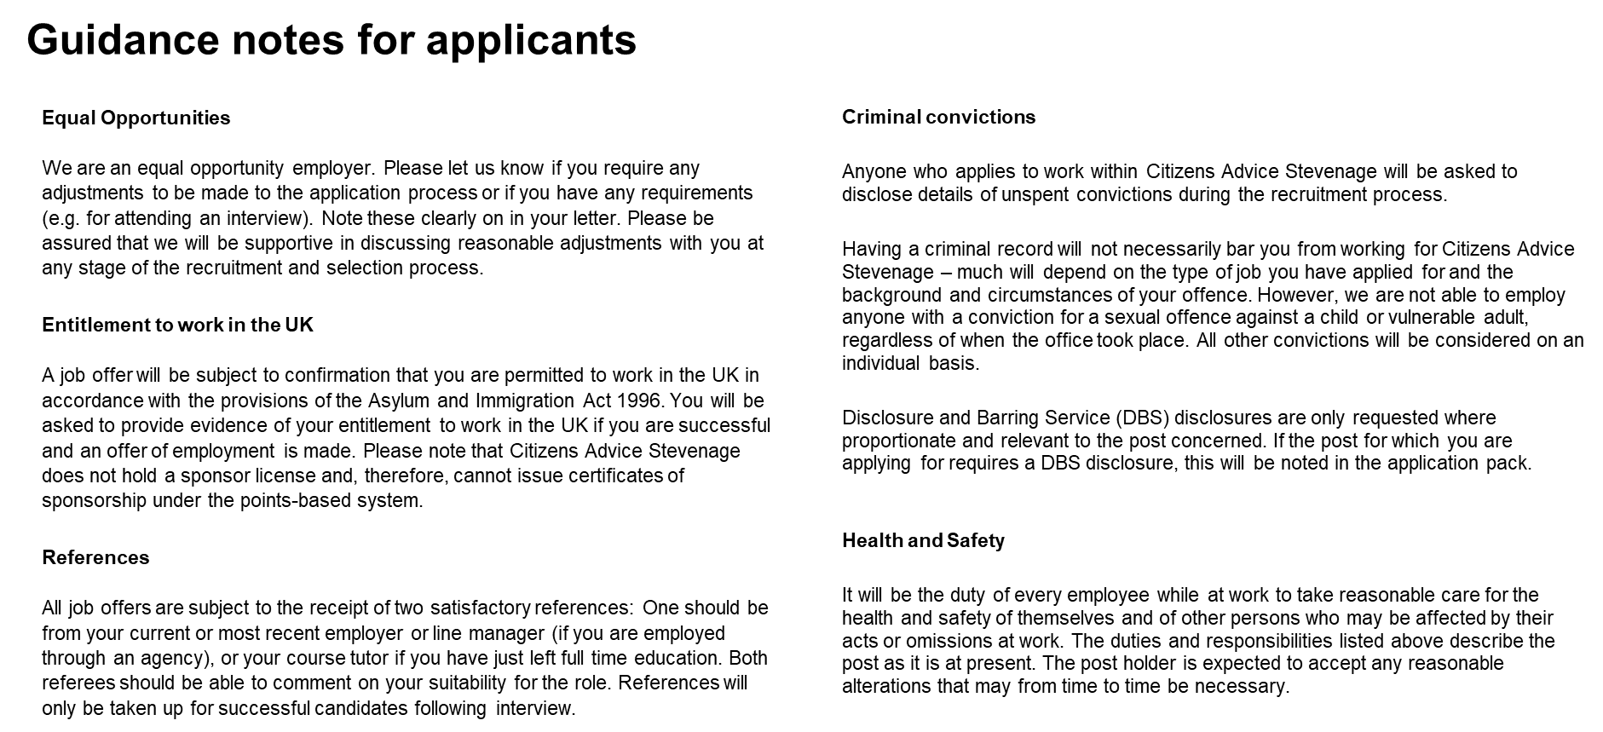

Slide 10
Addressing each point of the person specification
This is a key section of the application which allows you to provide evidence of your experience, knowledge, skills and abilities that are relevant to the role as described in the role profile. Selection is based on an assessment of the evidence you provide against the requirements of the role as set out in the person specification. It is important that you tailor your response to clearly demonstrate how you meet each requirement. No assumptions will be made about your achievements and abilities.
Please provide one example for each requirement. You should choose examples of past experience that clearly demonstrate what we are looking for, and be precise about what you did, how you did it and the outcome or result of your actions. Please try to limit your response to each criterion to a maximum of 200 words.
A useful guide might be S.T.A.R:
Specific – give a specific example
Task – briefly describe the task/objective/problem
Action – tell us what you did
Results – describe what results were achieved
Please provide recent work examples wherever possible. However, do remember that relevant examples from other aspects of your life, for example: voluntary or unpaid work, school or college work, family or home responsibilities, can also be given.

